Slide 1
MD5 Algorithm
Muhammad Naufal P.P
Ugi Ispoyo Widodo

Slide 2
Background
High human needs to the future require people to continue developing the technology owned. Human create solutions to overcome many problems, and now appears an algorithm used for security applications, one of them is MD5 algorithm.

Slide 3
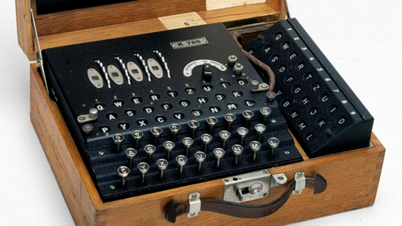
Definition of Cryptography
Cryptography is the conversion of data into a secret code for transmission over a public network.

Slide 4
Definition of Encryption
The process of encoding message that may it be read only by the sender and the intended recipient. Encryptions system often use two keys, a public keys, available to anyone, and a private key that allow only there recipient to decode the message

Slide 5
History of MD5 Algorithm
- In 1990, Ron Rivest invented the hash function MD4.
- In 1992, he improved on MD4 and developed another hash function: MD5.

Slide 6
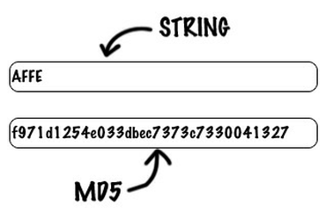
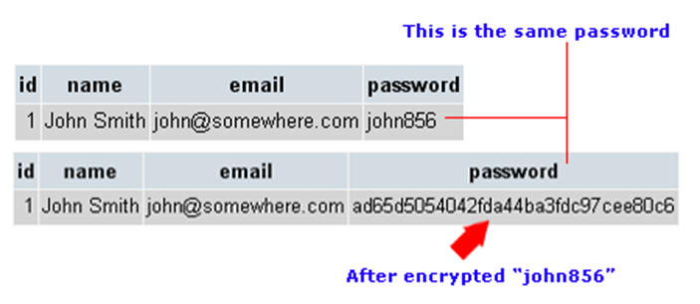
Definition of MD5 Algorithm

Slide 7
MD5 Algorithm
- MD5 is a one-way hash function created by Ron Rivest.
- MD5 is an improvement on MD4 after MD4 found.
- MD5 algorithm accepts input in the form of a message with any size and produce a message digest that is 128 bits in length.

Slide 8
How to Work of MD5 Algorithm
Appending Padding Bits
Appending Length
Buffer Initialization
Processing of the Message
Output

Slide 9
Advantages of MD5 Algorithm
Utilizes a Fast Computation Algorithm
Provides Collision Resistance
Widespread Used
Provide a One Way Hash

Slide 10
Disadvantages of MD5 Algorithm
Security Flaws and Vulnerability
Less Secure than SHA-1 Security
Slower

Slide 11
Conclusion
The MD5 message-digest algorithm is simple to implement, and provides a fingerprint or message digest of a message of arbitrary length.

Slide 12
Suggestion
In the use of MD5 Algorithm we must have a basic knowledge of internet, coding, and security manage. So, we will not have problems in relation interface to come. While the technology can prove to be a great asset, it could also cause harm if not understood and used properly.

Slide 13
Thank You!

